Slide 1

Welcome and Today’s Agenda
13.00-13.20 Welcome! And British Academy Project update
13.20–14.00 Lisa Ingleby, Alternative Provision and Inclusion Provider, Durham County Council
Supporting transitions from primary to secondary school
‘Child first’ approaches to tackling serious youth violence and child criminal exploitation
14.00-14.20 BREAK
14.20 - 15.40 PAC team, NE Youth
15.40-16.00 Final group discussion
Social action, Youth Voice Toolkit, and ‘moving from consultation to co-production’
‘

Slide 2

Scrutinising ‘child first’ policy and practice and its application to children involved in serious violence
Dr Rebecca Oswald, Professor Sarah Soppitt and Dr Samantha Walker
Northumbria University
November 7th 2025

Slide 3
Update on Research - Scrutinising ‘child first’ policy and practice and its application to children involved in serious violence (SYV)
A big thank you to all those who have participated in this research.
Aims of this research –
To build a greater understanding of the picture of SYV and related issues across the North East,
To develop a deeper understanding of what is meant by ‘child first’ principles and if and how these are/can be translated into policies to tackling SYV.
To understand if and how ‘child first’ narratives are currently understood and implemented in policy and practice across multiple social systems (criminal justice, education, social care, health and third sector) for children involved in SYV.
The focus of this research is on developing a more comprehensive and/or shared understanding of ‘child first’ which can be used to inform effective public health-based strategies for supporting young people impacted by serious violence.

Slide 4
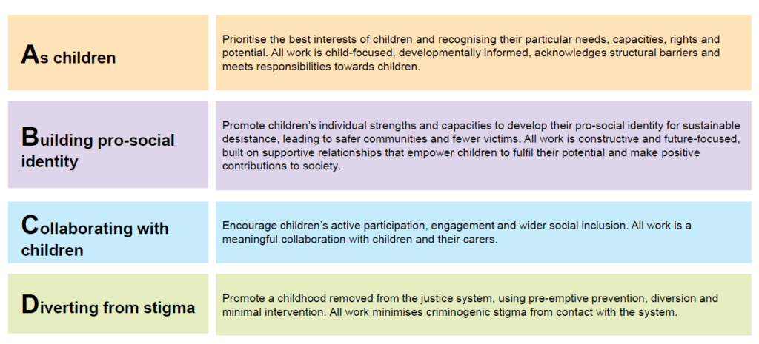
Child First – Youth Justice Board definition

Slide 5
Update on Research - Scrutinising ‘child first’ policy and practice and its application to children involved in serious violence
Where have we got to?
Conducted interviews and small focus groups with 38 key stakeholders including
  Youth justice services
  Education services and alternative provision
  Children’s social care and risk outside the home teams
  Police, including seconded YJS officers and missing from home departments
  Health services, including Forensic CAMHS
  Third sector organisations
Dra
Drawn from areas across the North East including Newcastle, North Tyneside, Durham, Darlington, Stockton-on-Tees, Redcar and Cleveland and North Yorkshire
Small focus groups with 51 young people involved in or at risk of involvement in SYV and their parents

Slide 6
Key findings from analysis so far – where are our agencies in terms of ‘child first’?
YJS – findings mixed, some practitioners report always being ‘child first’ (trauma-informed, relational, child-centred, focus on diversion), others acknowledged that they are still in a process of moving towards ‘child first’, with work still needing to be done. Difficulties particularly with collaboration/co-production with children.
Police – increasing recognition that there isn’t a single agency decision around children, enforcement response not always appropriate. Seconded police officers to YJS can play a key role. But fundamentally structures of policing are still process-driven; ‘child first’ is often incompatible with key performance indicators. Poor relationships reported between young participants and police.
Education - concerns over mainstream education’s systems of discipline, punishments, school exclusions – power dynamic in schools often not ‘child first’. But some schools are seeking to become more trauma-informed. Capacity for ‘child first’ can be greater in AP provision.

Slide 7
Key findings from analysis so far – where are our agencies in terms of ‘child first’?
CSC – dedicated exploitation teams are better positioned to build relationships with young people. Wider social services can struggle with ‘child first’ – stretched resources, high case loads, process-driven.
LAC provision – very mixed, reports of insufficient placements with those with the necessary skills to work with traumatised children. Available places and care options can be so limited that young people cannot exercise any agency in where they go. Sometimes young people are being housed in areas with known risks of CCE.
Third sector/youth services - Can play a vital role in providing youth clubs/activities where there is very little else – safe spaces. Generally, youth workers spoken very highly of by young people – ‘They chat with you and just make sure you are ok.’ Can be best placed to offer the consistency and relationship building needed for ‘child first’. Young people talked about a need for youth workers in schools.

Slide 8
Key findings from analysis so far – where are our agencies in terms of ‘child first’?
Health/Forensic CAMHS – naturally very trauma-focused, can work flexibly and in a child-centred way. But services can be very stretched, and become more process-driven than ‘child first’.
Youth courts – structure and environment reported to be incompatible with ‘child first’. Some report however that magistrates and judges are very well informed about ‘child first’ practice.
Youth custody - tbc

Slide 9
Key findings from analysis so far – what are the barriers and what needs to change?
Gendered assumptions and adultification, particularly of older children and those who exploit others
Assumptions that ‘child first’ cannot be balanced with protecting the public, responsibility to victims
Acknowledgement that a lot of barriers are at a system, rather than individual level “In considering child first, you've got to be aware of that wider context, and how it can realistically operate in the current system” – Stakeholder 25
Stretched statutory agencies becoming more process-driven, limited capacity for relationship building, lack of consistency in key workers – yet trusted relationships are absolutely key for a child first approach and to tackle and prevent SYV
Sharing information between agencies is critical – and ability to pool resources to fill gaps rather than moving children and young people between agencies

Slide 10
Key findings from analysis so far – what are the barriers and what needs to change?
Coherence between agencies is crucial: “Everyone has different remits, but partners don't always understand that child first needs a full commitment to see the bigger picture of the young person's offending, as only one aspect of their lives” – Stakeholder 8
‘Diversion’ is not always what children involved in/at risk of SYV need
‘Child first’ does not necessarily acknowledge the role of the adults, family, wider network around the young person that play a role in SYV/CCE
Transition to adult services at age 18 – particularly relevant to many young people involved in SYV

Slide 11
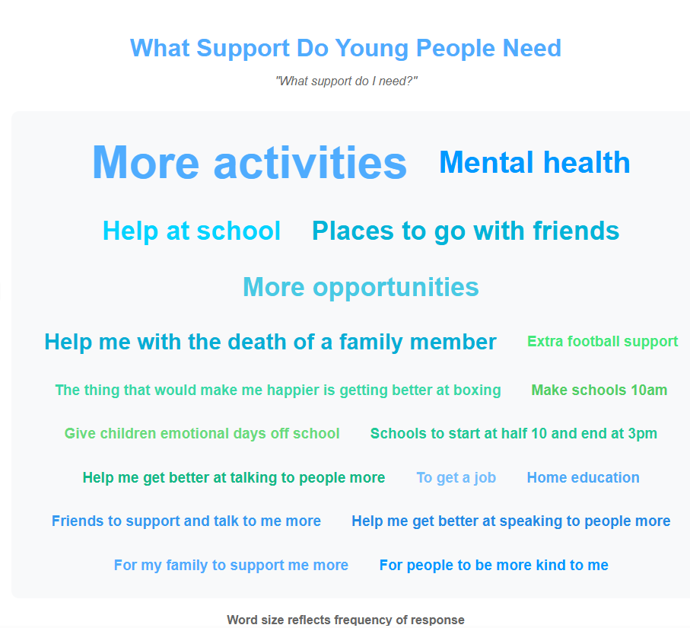
Children and Young People’s word clouds

Slide 12
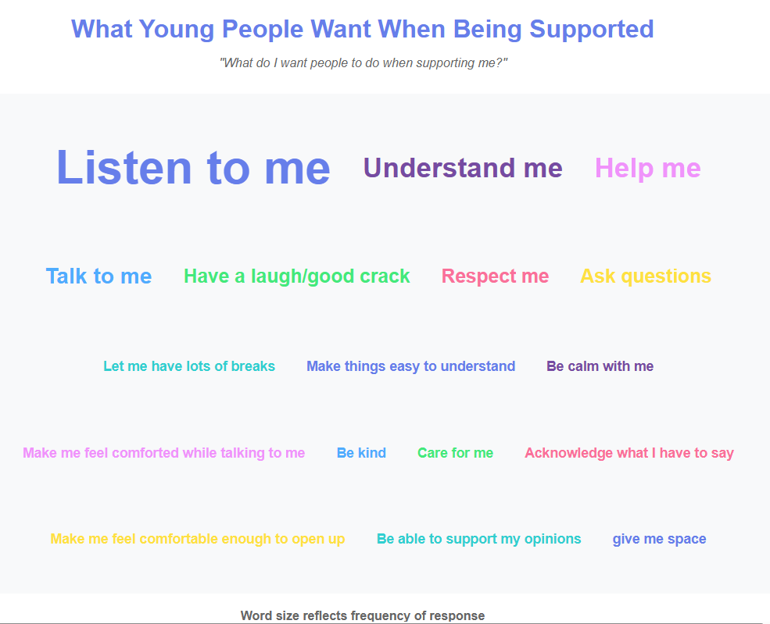
Children and Young People’s word clouds

Slide 13
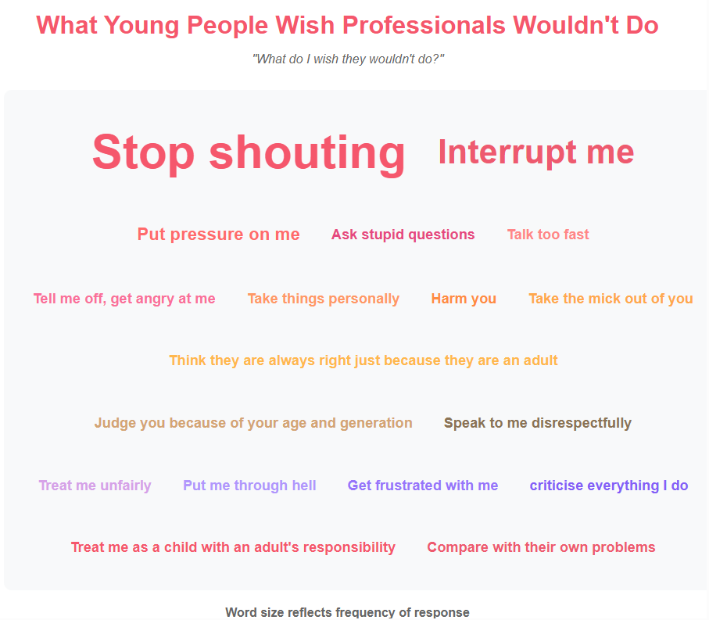
Children and Young People’s word clouds

Slide 14
Discussion –
What does ‘child first’ mean in your context?
How could a more joined up approach to ‘child first’ be taken across agencies? What might need to change?
Are ‘child first’ policies and practices an effective way to tackle issues of serious youth violence?
N.B. If you are ok with sharing some of your thoughts from this discussion, please complete the worksheet and leave it behind when the workshop ends. These will be used (anonymously) to help inform the findings of this research.

Slide 15
What next?
Continuing document analysis: we are looking to gather supporting documents that illustrate how participating agencies approach work with young people involved in, or at risk of, serious youth violence.
We would therefore be really grateful if you could share any materials that reflect your service’s methods, processes, or tools in this area.
This could include, for example:
Risk assessments
Case management documents (e.g., action plans, reviews)
Session resources or worksheets
Young people’s feedback forms
Closure summaries
We anticipate that, in most cases, blank templates will be the most appropriate format to share.
Please email to saferchildren@northumbria.ac.uk
Still some interviews to complete
Final dissemination webinar month 18 of project
Final report and research infographics month 18 of project

Slide 16
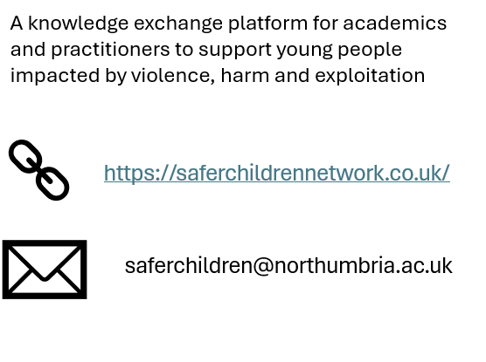
A big thank you for your contributions today
If you have come along today and are not already part of the Safer Children Network, please leave your email address if you would like to be added to the distribution list. We mainly limit emails to letting members know about our upcoming events and distributing materials after events.

