Slide 1


Co-production with Children in
Youth Justice
High-Risk Panels

Slide 2



Todays
Webinar
Part 1. Explore
Complexity of participation
with ‘high risk’ children
Part 2. Reflect
Purpose of managing risk &
what this means within a
Child First framework

Slide 3

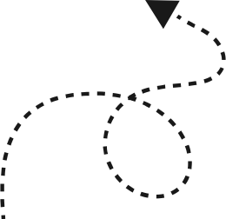
Part 1
Exploring complexity of particiaption with ‘high risk’ children

Slide 4

Negative perceptions / Social Stigma
can increase likeliness of re-offending
Risk in
youth
justice
Adult - centric
Punitive approach?
Neglect of childrens voices in youth justice processes
over-responsibilise chidlrens behaviours
affects relational practice with child
identity as ‘risky’ young person
(Case 2023, Day 2023, Deakin et al. 2022, Kemshall 2008)

Slide 5



MANAGING RISK, REDUCING HARM OR FOCUSING ON SAFETY?
managing risk of offending /
re-offending
Keeping others safe
safeguarding children

Slide 6
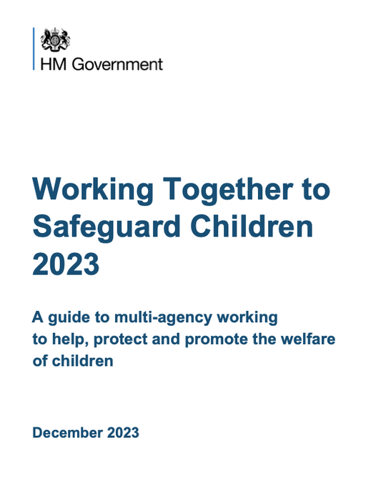
Policy context in England:
Multi - agency approaches to safeguarding and managing risk
  Contextual safeguarding (Firmin 2020)
  Integrated services (Byrne 2023)
  local divergence of youth justice practice (Smith and Gray 2019)
  working together guidance (2023)
  Trauma-informed and relational practice (Harris et al. 2020)

Slide 7
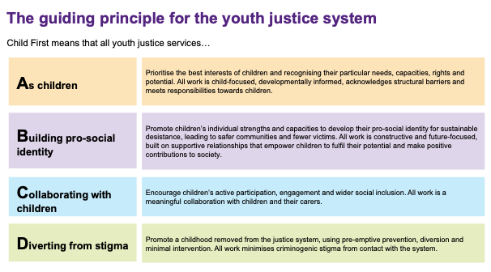
Policy context in England: Child First

Slide 8
PARTICIPATION AND CO-PRODUCTION IN YOUTH JUSTICE
address power inequalities
involuntary basis
Confusing terminology
a form of protection
challenge and transform
Participation contingent on behaviour/risk
(not inclusive of all children)
"It is a fundamental right for children to be provided with opportunities to determine the response to problems associated with their behaviour”
(Smithson et al. 2020)
Notes:
across research issues have arose out of 'how best to do pariticipation / co-production
talk about our research findings
peer power work?
PYP project?

Slide 9
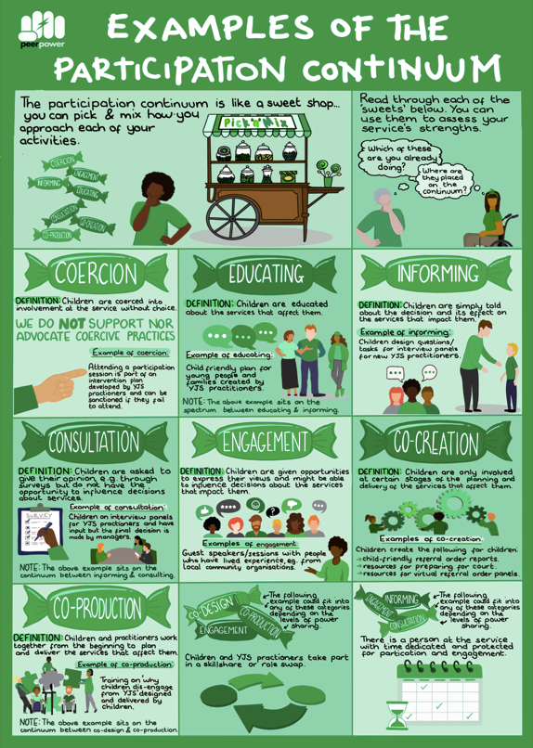
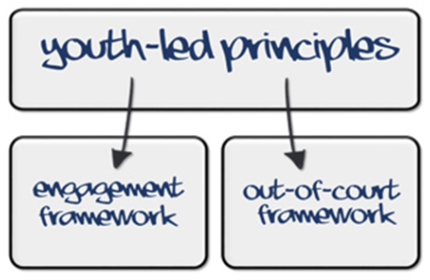
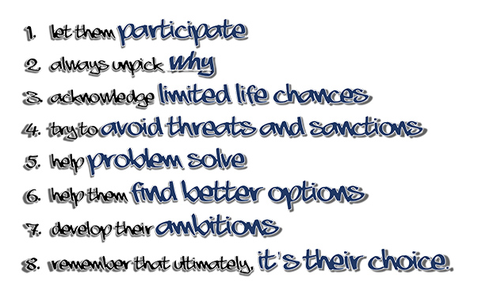
(Peer Power / YJB 2021, Smithson et al. 2021)

Slide 10

PARADOX OF PARTICIPATION & MANAGING RISK OF HARM
e.g 1
No participation or very tokensitic
e.g 2
particiaption occurs in current panel setting
CAUSING MORE HARM

Slide 11

RISK ASSESSMENT
& MANAGEMENT
HARM
JUSTICE
CRIMINAL IDENTITY
High Risk Panels
COMPLEX AND CONTRADICTORY
PREDICTING OFFENDING BEHAVIOUR
COERCION
RISK
CO-PRODUCTION IN HIGH-RISK PANELS
RESPONSIBILITY
CHILDRENS RIGHTS
SAFEGUARDING
KEEPING OTHERS SAFE
VULNERABILITY
NEED
PROTECTION
PUBLIC PROTECTION
SAFETY

Slide 12
Part 2
Reflecting on the purpose of managing risk and what this means in a child centred or Child First context?

Slide 13

WHAT DOES IT MEAN WHEN A CHILD IS HIGH RISK?

Slide 14
WHAT IS THE PURPOSE OF A HIGH RISK PANEL?

Slide 15
HOW COULD CHILDREN PARTICIAPTE IN MULTI-AGENCY PANELS WITHOUT CAUSING FURTHER HARM?

Slide 16


FINAL REFLECTIONS
HOW CAN CHILDREN’S PARTICIPATION MORE EFFECTIVELY ADDRESS HIGH-RISK CONTEXTS?
HAS OUR UNDERSTANDING OF RISK MANAGEMENT CHANGED (OR DOES IT NEED TO?)
ARE THERE BETTER WAYS OF ADDRESSING THE COMPLEXITY OF SERIOUS HARM IN CHILDREN’S LIVES?

Slide 17


If you would like more information about our work, or would like to be involved in our research, then please contact me!
Dr Samantha Burns
Samantha.burns@mmu.ac.uk

Slide 18
REFERENCES & FURTHER READING
  Burns, S. and Creaney, S. (2023), “Embracing children’s voices: transforming youth justice practice through co-production and Child First participation”, in Case, S. and Hazel, N. (Eds), Child First: Developing a New Youth Justice System, Palgrave Macmillan, London.
  Carr, N and Smith, R (2023) Youth justice: local and global. London: Sage.
  Case S (2021) Youth Justice: A Critical Introduction. Oxford: Routledge.
  Creaney, S. and Burns, S. (2023), “Freedom from symbolic violence? Facilitators and barriers to participatory practices in youth justice”, Youth Justice, doi: 10.1177/14732254231156844.
  Creaney, S. and Smith, R. (2023), ‘Social work and youth justice’, in J. Parker (ed) Introducing Social Work (2nd edn), London: Sage
  Day, A., Malvaso, C., Butcher, L., O’Connor, J. and McLachlan, K. (2023) ‘Co-producing trauma-informed youth justice in Australia?’, Safer Communities, 22(2): 106–20
  Douglas, A.- M. (2022) ‘Toward a system that heals: exploring empathy and its application to youth justice and children’s education, health and social care services’, Peer Power Youth
  Haines, K. and Case, S. (2015) Positive Youth Justice: Children First, Offenders Second, Bristol: Policy Press.
  Johns, D., Flynn, C., Hall, M., Spivakovsky, C. and Turner, S. (2022) Coproduction & Criminal Justice, Abingdon: Routledge.
  Smithson, H., Gray, P. and Jones, A. (2020) ‘“They really should start listening to you”: the benefits and challenges of co- producing a participatory framework of youth justice practice’, Youth Justice, 21(3): 321– 37

