Slide 1



Trauma-informed care for Children and Young People who are considered “high risk, high harm and high vulnerability”:
The Framework for Integrated Care (Community)
Dr Aisling Martin, Consultant Clinical Psychologist, Trusting Hands Gateshead

Slide 2
Acknowledgements
Dr Tim Diggle, Consultant Clinical Psychologist, Future Focus Newcastle
Andrew Nichols-Clarke, Development Senior Lead, H&J Children Programme, NHSE

Slide 3
Aims
To describe our understanding of “high risk, high harm, high vulnerability” needs
To introduce the Framework for Integrated Care (Community)
To provide an overview of the implementation of integrated trauma informed care services – Trusting Hands Gateshead and Future Focus Newcastle

Slide 4
Our cohort: children with complex needs
This cohort of children often have complex needs in multiple domains and are sometimes described as “high risk, high harm, high vulnerability”. They may:
Have a higher likelihood of having been subjected to Adverse Childhood Experiences (ACEs)
Have challenges in developing secure attachments.
Have experienced high levels of social disadvantage.
Have multi-layered, unmet and complex needs.
Not be accessing services in a timely manner in the first place, despite high levels of need.
Have a higher likelihood of having been subjected to trauma or severe neglect.
Notes:
Plain slide with subhead and bullets

Slide 5
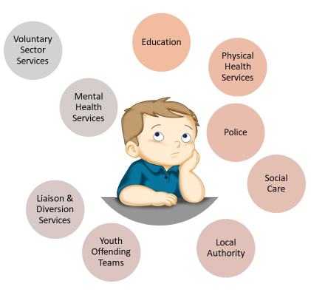
Complexity

Slide 6
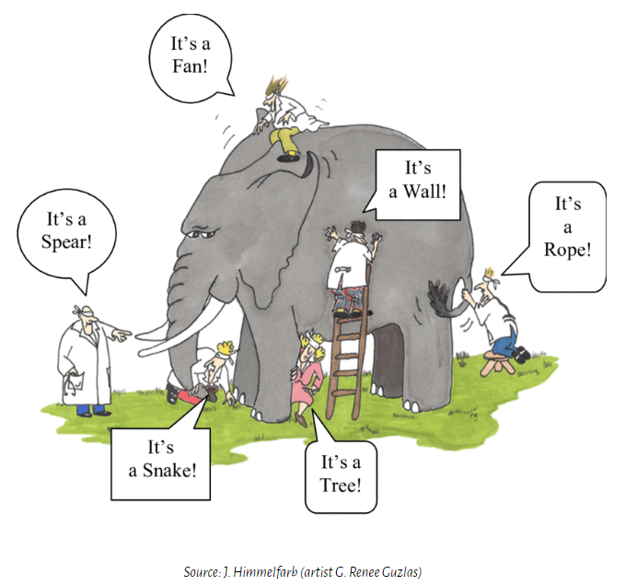
A shared understanding

Slide 7
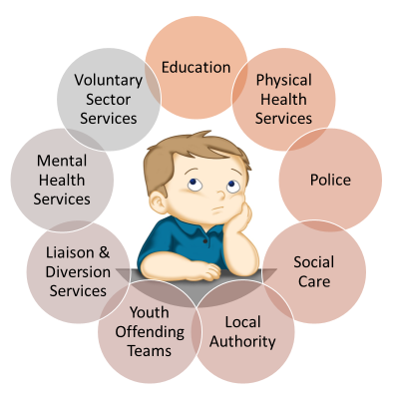
Integrated care

Slide 8
“High risk, high harm, high vulnerability” needs
Multiple (ie not just in one domain, such as mental and physical health)
Persistent (ie long term rather than transient, including for example learning disability, autism or both)
Severe (ie not responding to standard interventions)
Framed by family and social contexts (ie early family disruption, loss, inequality, prevalence of Adverse Childhood Experiences).

Slide 9
What?
Framework for Integrated Care
Framework for Integrated Care (FIC) offers a coherent framework for a comprehensive, trauma-informed system of care that unifies staff and services.
Framework for Integrated Care (SECURE STAIRS)
Framework for Integrated Care (Community)
Oasis Restore Framework
How?
Notes:
Plain slide with subhead and bullets

Slide 10
Framework for Integrated Care: A System Approach
The Framework for Integrated Care provides a set of guiding principles and practices, that act as a template for genuine co-production and development of integrated services for children and young people with complex needs.
It represents a shift in ideology, moving away from approaches that seek to fix ‘what is wrong with you’ to approaches that seek to understand and address ‘what has happened to you’.
The Frameworks, both SECURE STAIRS and Community, aim to provide a ‘scaffold’ for innovative working practices and collaborations across systems and partners to enhance services that seek to prevent re-traumatisation and enable children and young people, with complex needs, to thrive.
The Framework for Integrated Care being implemented in Oasis Restore Secure School is referred to as Restore.

Slide 11








The Framework for Integrated Care (Community) - Principles
1. Every Interaction Matters: There is a focus first on building and supporting positive collaborative relationships.
2. Children & young people and the relationships they experience are at the centre of all care they receive through genuine co-production.
3. Those spending most time with young people are the primary facilitators of change.
4. Positively influencing the day to day care is the basis of any intervention and the primary focus of support.
5. All behaviour is understandable in context; there is a focus on developing an understanding of each children & young people's behaviours and needs based on their story (Formulation).
6. There is a commitment by all to build and sustain trauma informed organisations.
Notes:
Sample icon grid slide – 6 icons (inc. alt text)

Slide 12
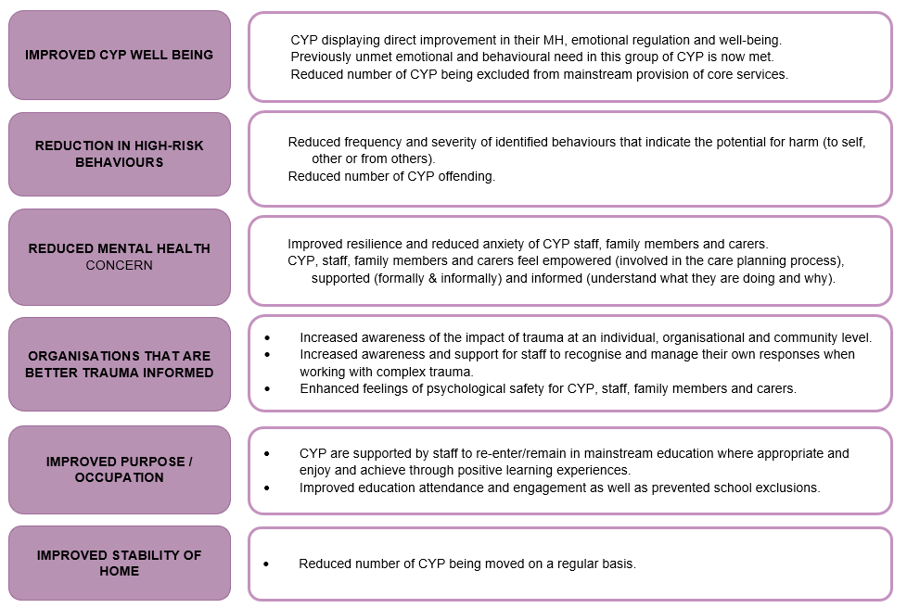
Outcomes

Slide 13
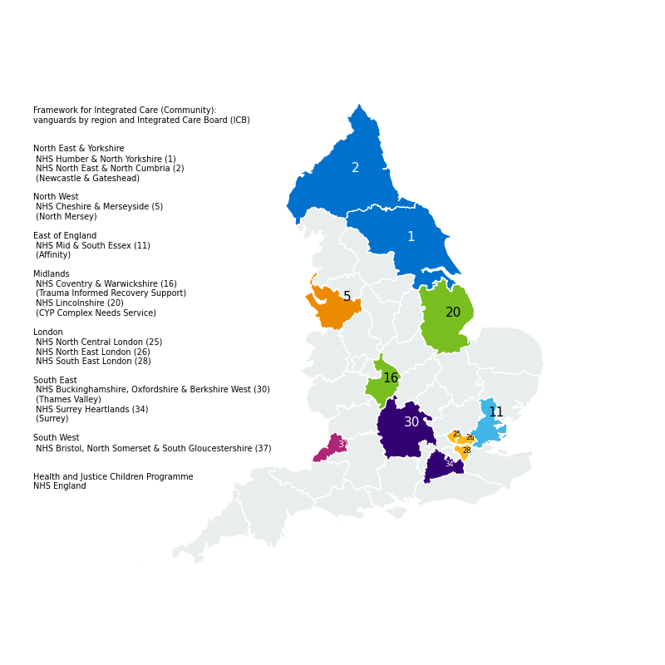
Framework for Integrated Care (Community): Vanguards by region & Integrated Care Board (ICB)
Notes:
”Quote” slide with placeholder for image on right hand half

Slide 14
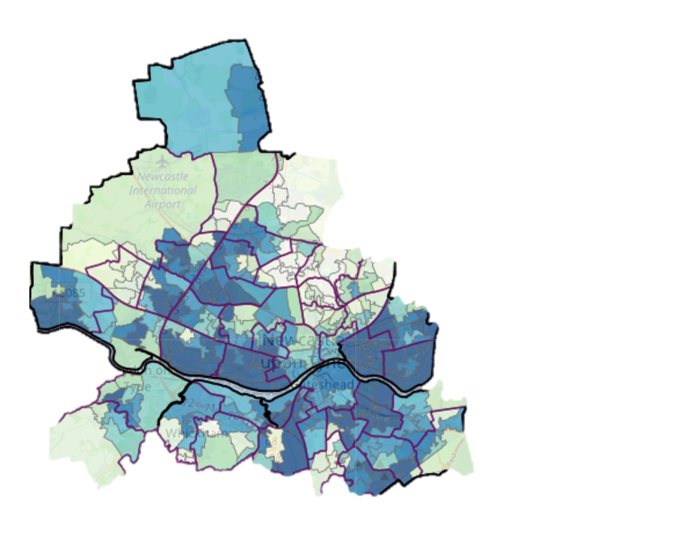
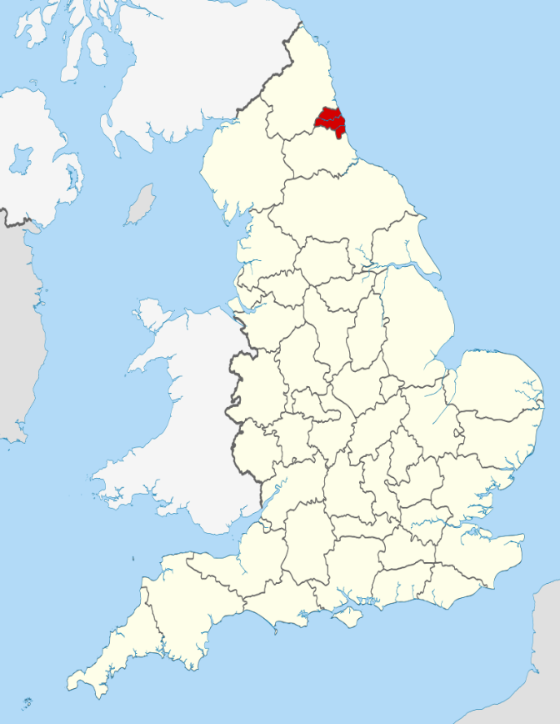
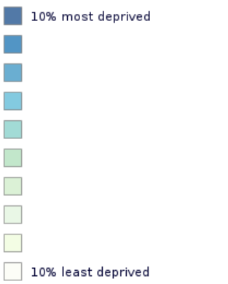
Newcastle and Gateshead
Indices of Deprivation Map, 2019

Slide 15
Newcastle Demographics
Children and young people under the age of 18 years.
62,900
Children and young people open on Child in Need plans
Children and young people open on Child Protection plans
Cared-for Children and young people
Children and young people open to YJS
858
465
600
130

Slide 16
Gateshead Demographics
Children and Young people under the age of 18 years.
39,319
Children and young people open on Child in Need plans
Children and young people open on Child Protection plans
Cared-for Children and young people
Children and young people open to YJS
1520
257
510
46

Slide 17



The Teams
Developed in partnership between Newcastle & Gateshead Councils and CNTW
Psychology, Speech and Language Therapy, Occupational Therapy & Advanced Practitioners
Embedded into Children in Care teams, Youth Justice, Contextual Safeguarding and Residential Care

Slide 18

Trusting Hands ‘connected teams’
• Fostering
• Kinship
• Residential
• Children in our care
• Care Experienced
• Youth Justice Service
• Contextual Safeguarding
The core offer is also available to care teams around children subject to local authority care who are supported via other Children’s Services teams (e.g., Disabled Children’s Team or Safeguarding).

Slide 19
Key interventions
Consultation
Understanding the Story (Trauma-Informed Formulation / Enhanced Case Management)
Training
Scaffolding and supervision
Reflective Practice
Contributions to multiagency care and risk planning
Liaison with multiagency partners
Strategic and organisational influence

Slide 20

Scaffolding
Understanding the Story
Connected conversation consultation clinics
Reflective Practice
Foundations for Attachment
Supporting Trauma-Informed Systemic Thinking
Notes:
Ensure to mention training when discussing bottom line re systemic thinking

Slide 21
Organisational support
Workforce training programme
Trauma-informed champions
Reflective practice
Review of paperwork and interventions
Support to develop debrief processes
Trauma informed influence through attendance at strategic partnership meetings

Slide 22
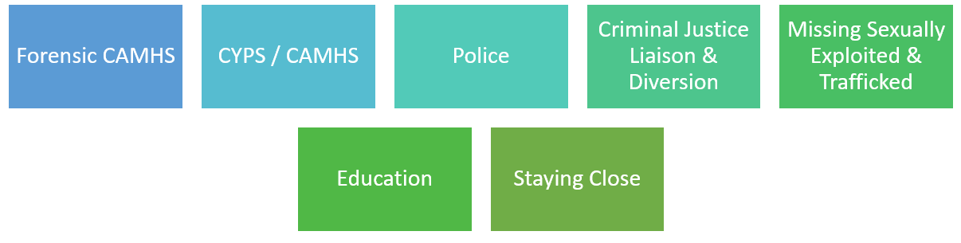
Interfacing services

Slide 23
Year One Activity (2020/4)
Trusting Hands & Future Focus

Slide 24
Referrals
Total number of referrals: 341

Slide 25
Consultations
Total number of consultations: 861
Notes:
Recordings – methods of recording our activities and interventions

Slide 26
Formulations
Total number of formulations: 72

Slide 27
Reflective Practice
Reflective Practice is offered to a range of professionals including:
Residential care home managers and deputy managers
Residential care home staff
Child Social Worker
Social Work Managers
Foster carers
Supervising Social Work Managers
YJS managers
YJS workers
Total number of reflective practice sessions: 94

Slide 28
Foundations For Attachment (FFA) Attendees
Total number of attendees in FFA sessions over 6x 6-week courses: 49

Slide 29
Outcomes
Trusting Hands & Future Focus

Slide 30
Formulation feedback
Wilcoxon Signed Ranks test were used to examine pre- and post- formulation scores on staff experiences of attending a formulation meeting. The findings from 200 attendees indicated that there were significant post-formulation improvements across all domains measured. The domains included improvements in the following:
Knowledge (W = 13333, p = <.001, effect size = 0.97)
Confidence working with the young person (W = 9831, p = <.001, effect size = 0.94)
Motivation (W = 1654, p = <.001, effect size = 0.59)
Understanding of behaviours (W = 12583, p = <.001, effect size = 0.93)
Satisfaction with the plan (W = 11429, p = <.001, effect size = 0.92)

Slide 31
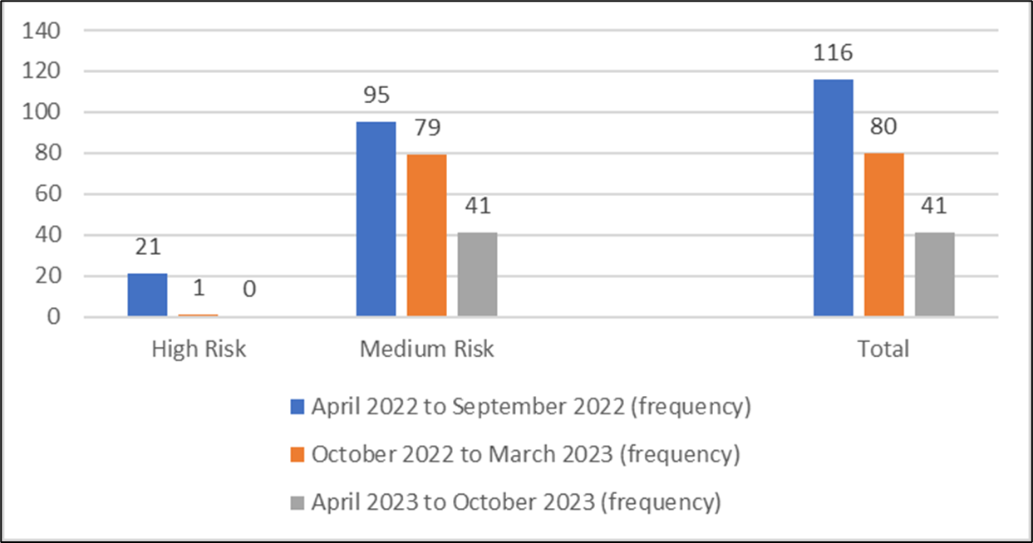
Anonymous case example
Frequency of missing intervals by risk level

Slide 32
Financial implications – All services
Time period | Approximate cost of missing episodes
April 2022 – September 2022 | £52.8K
October 2022 – March 2023 | £516K
April 2023 – October 2023 | £568K

Slide 33
Anonymous case example
6yo Child In Our Care with significant history of developmental trauma.
Three placement moves in 6 months.
Residential placement search commenced August 2023. Agreement to prioritise foster placement searches for 8 months.
Support provided to foster carer:
  Foundations for attachment therapeutic parenting programme
  ‘Understanding the story’ multiagency formulation and dynamic reviews
  Initial weekly support calls (later reduced in frequency)
  Support to the system to manage education move
  Further consultation and guidance to social worker
  Placement has been maintained for 11 months (18 months in total). Child’s presentation has significantly improved due to the stability and safety offered.

Slide 34
Financial implications
 | Foster Carer | Therapeutic Residential Care
Weekly cost | Level 4 - £453 (plus allowances) | £5,000
Total cost (11 months) | £19, 932 | £220, 000
Total saving | £200,068

Slide 35

Questions, comments or reflections?
Thank you for listening

Slide 36
Contact
Trusting Hands Gateshead
Email: TrustingHands@Gateshead.gov.uk
Dr Aisling Martin, Consultant Clinical Psychologist
Email: AislingMartin@Gateshead.gov.uk
Future Focus Newcastle
Email: Futurefocusfostercare@newcastle.gov.uk
Dr Tim Diggle, Consultant Clinical Psychologist
Email: Tim.Diggle@Newcastle.gov.uk
Framework for Integrated Care
Email: england.complexneedscyp@nhs.net
Andrew Nichols-Clarke, Head of Health & Justice Children Programme, NHS England
Email: andrew.nichols-clarke@nhs.net

