Slide 1



Rebecca Cheesman (Team Manager)
Louise Stephens (Deputy Team Manager)

Slide 2
Why do we need to do things differently?
In 2018, a young person, Tom, died following a significant assault whilst he was riding an off-road bike through his community. The learning lessons review identified he was deemed to present a high level of anti-social behaviour (ASB) in his community particularly as this related to off road motorbikes. There was a significant history of ASB, intra and extra familial harm and likelihood that he was distributing cannabis in his community (indicative of the current exploitation model).
In early 2020, a young person suffered life-changing injuries following loss of limb after he was shot. Daniel was an exploited young person and went on to be the Principal member of an Organised Crime Gang (OCG). He is currently serving a lengthy custodial sentence.
A third, thematic review has been completed following a young person being charged and trialed for murder, with a history of intra and extra familial harm related to drug activity, exploitation and serious violence. Also, a child death where a young person died following a motorbike accident. There were concerns around exploitation and associated harm as a victim and alleged perpetrator of serious violence.
In recent months we have all seen a serious escalation in the use of serious violence and crime in Redcar & Cleveland, including offences of attempted murder and section18 woundings. As a result several Osman Warnings (Serious risk to life issued by the police) have been issued, requiring an immediate response by Children’s Services.
As providers of services to children, we need to respond quickly and differently to children who are experiencing risk outside the family home (ROTH).

Slide 3
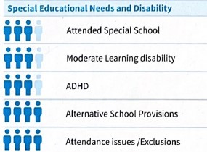
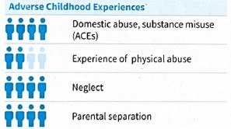
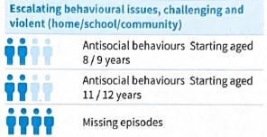
Findings from 4 recent and Local
Thematic & Safeguarding Practice Reviews
Notes:
ACE’s
Neglect
Parental Separation
All went to mainstream primary schools
MFH episodes
Early identification
Led to us wanting to reach out and raise awareness with schools to identify early
Links to exploited children who experience school exclusions and attendance issues.
Recent research found that for children experiencing extra-familial harm:
Over half were not in mainstream education provision.
The vast majority had experienced some type of exclusion at school. A fifth had experienced permanent exclusion.
‘Disruptive behaviour’ and ‘attendance and punctuality’ were the most common reasons given for why a child experienced permanent exclusion or any form of exclusions.
Children and young people were excluded for reasons that were strongly associated to their experiences of extra-familial harm.

Slide 4
What have we done?
2021
Partnered with the DfE to launch our No Wrong Door children's hub
2022
Worked with Professor Carlene Firmin and the DfE to pilot ROTH
2023
Sought funding from external partners to create the SAFE team
2024
Revised our MFH practice to better meet the needs of C&F
2024
Secured Department of Leveling up funding to launch R&C SHiFT
Notes:
No Wrong Door – DfE
Worked in partnership locally and with the DfE, NYCC and other national adopters to develop our model and learn from their experience and expertise Ofsted, NYAS, C&YP, police, CAMHS, SALT
ROTH- DFE
We are working in conjunction with Professor Carlene Firmin and Durham University to develop ROTH. We are one of only three LAs in the country to secure this support
SAFE
Reflected upon national best practice and what works with exploited children to build the team concept and define their roles
MFH – critically self-reflected on current practice. Revised our approach to MFH, NWG, national best practice guidelines, multi-agency partners and Ofsted recommendations

Slide 5
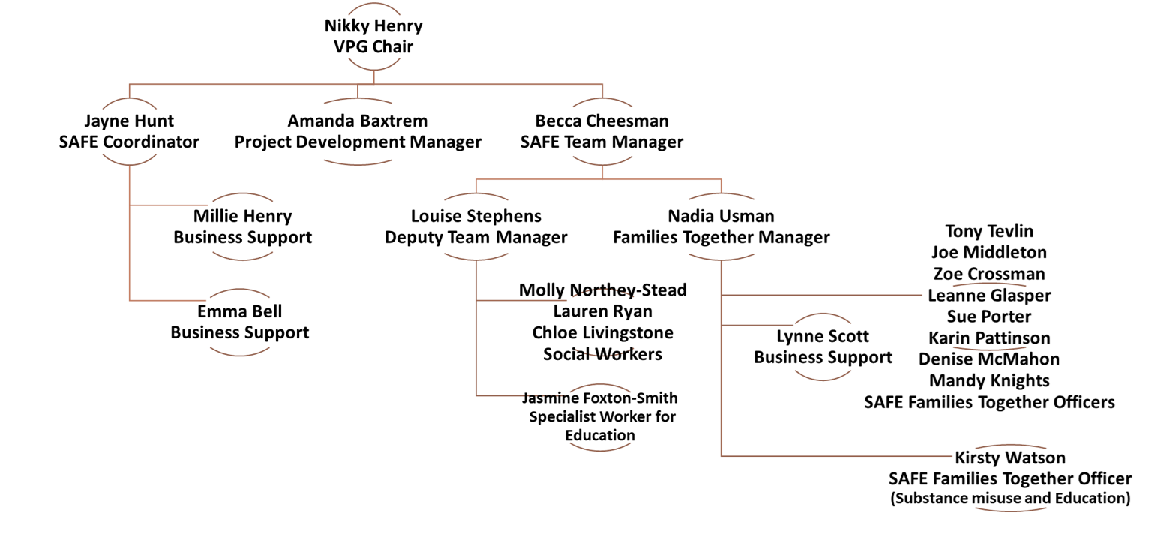
Our Team
Notes:
SAFE
Reflected upon national best practice and what works with exploited children to build the team concept and define their roles
Extended the remit of our families together/ edge of care workers to include exploitation and MFH.
1 x DTM – Staying Close – DfE
3 x SW posts – DfE
1 x specialist Education worker – public health
1 x specialist substance misuse and education worker – public health
Recruitment timeline
SAFE Specialist Families Together Officer (Substance misuse and Education) commenced post December 2023
SAFE Social Worker 30 hours - commenced post January 2024
SAFE Social Worker FTE - commenced post February 2024
SAFE Deputy Team Manager FTE - commenced post April 2024
SAFE Social Worker FTE - commenced post June 2024 (Social work posts filled from this month)
SAFE Specialist Education Officer 27 hours - commences post September 2024

Slide 6

Notes:
Raising awareness in community, with multi-agency partners, internally with children’s social care colleagues, Police and schools.
Focus on working with education colleagues and going into schools including primary schools – prevention, secondary – response and preventing exclusions, alternative provisions and SEN provisions around understanding and responding.
Prevention through working with those with early indicators such as MFH, ASB, substance misuse, low level crime.
Disruption – working with Police, community safety partnership and housing to tackle issues such as criminality, ASB, cuckooing, community orders, perpetrators, places, spaces.
Upskilling our own internal workforce and partner agencies around us through training, role modelling good practice

Slide 7
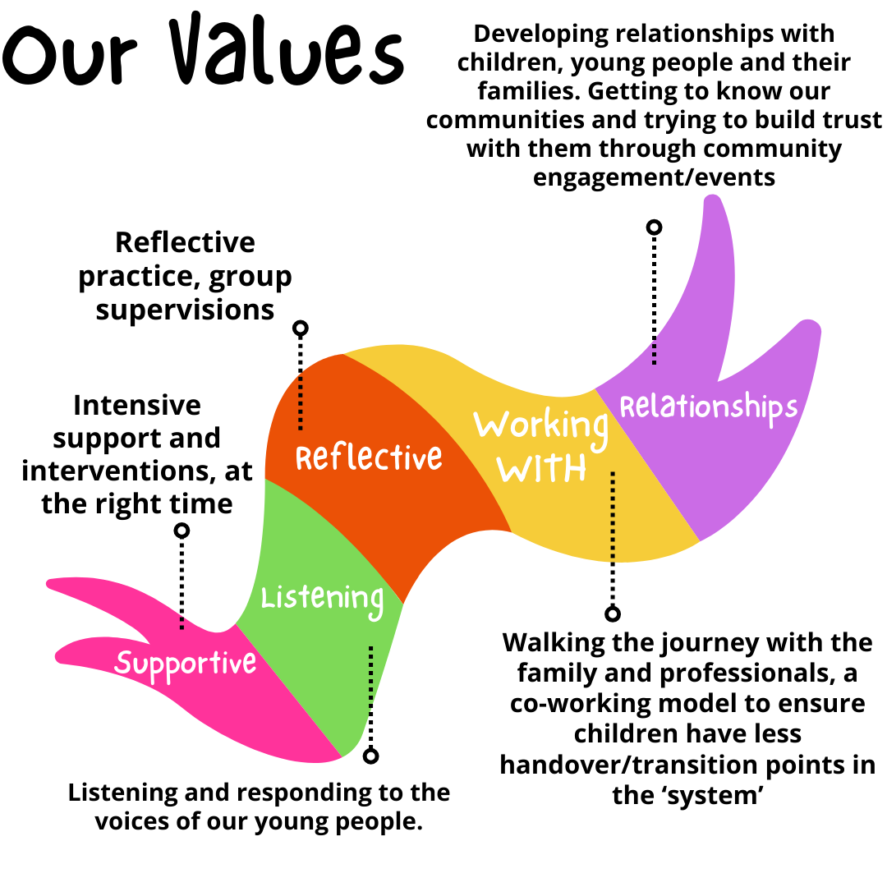
Notes:
Rationale for the Working Model
Joint working approach
Less transition/handover points within early help/social care
Relationship-building
Intensive support
Our work
Leading on all RHI’s for young people open to social care
Attendance at daily NPT meetings
Case supervisions facilitated
Strategy meetings facilitated
S47's led on
Risk assessments
Updating VEMT risk assessments for young people open to the VEMT forum.
Training to the social work teams, early help, ASYE’s and delivering sessions during Practice Week.
Providing case mapping/updates to the wider workforce providing information on Police intelligence.
Cross-boundary work with neighbouring Local Authorities and feeding back to internal and external local partner agencies.
Advice and guidance on NRM’s.
Advice and guidance on exploitation interventions, CCE toolkit, family pack, CSE interventions.
Advice and guidance on missing and return home interviews.
Feedback/learning/guidance arising from the weekly missing meeting and findings from RHI’s.
NRM
Allocated Safe Social Workers have submitted 3 National Referral Mechanism (NRM) referrals, resulting in 3 ‘Reasonable Grounds’ decisions and 1 ‘Conclusive Grounds’, in respect of a 17-year-old young person.
3 NRM’s were submitted by the SAFE Team in quarter 1.
For one NRM, there was an exceptionally quick turnaround with the timescales being:
NRM submitted by SAFE social worker 30/05/24
Positive Reasonable Grounds decision received 04/06/24
Positive Conclusive Grounds decision received 24/07/24
This is an exceptionally fast decision given the national timescales for conclusive grounds decisions are over 600 days. The NRM submitted was extremely detailed, clear and of good quality, which is deemed to have contributed to the SCA’s quick decision.

Slide 8
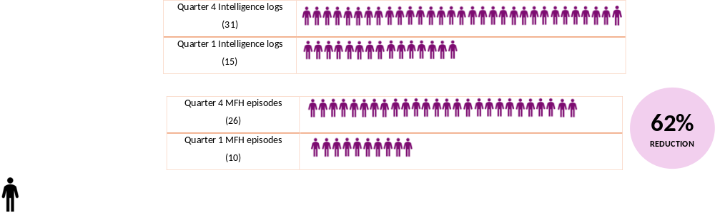

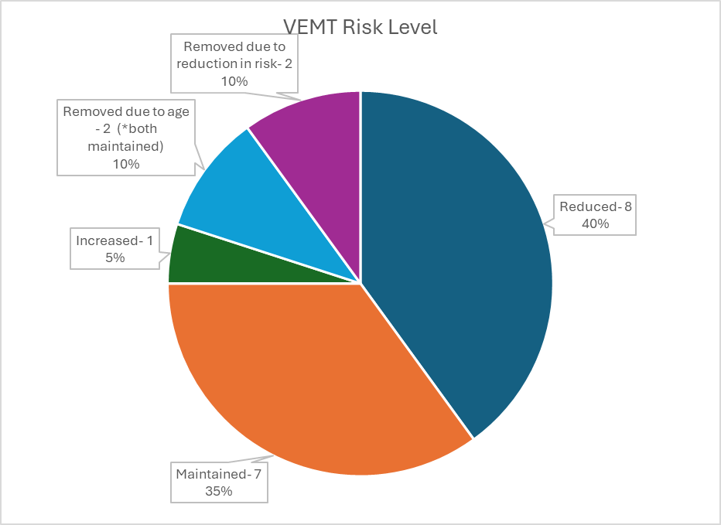

52% REDUCTION
SAVING 1ST QUARTER £22023
PROJECTED SAVING NEXT QUARTER £17,923
Notes:
Quarter 4 to quarter 1 figures
Since February 2024, 29 young people have been referred to and supported by the SAFE Team. Interventions and work completed by the team to date includes:
3P case mapping
Direct work using a variety of tools such as how safe do I feel, how safe is my child (with parents/carers/family members), Catch 22 CE recruitment with parents and young people
Relationship building
Responding to crisis
Return home interviews
Completing risk assessments
Leading on Strategy discussions and S47 assessments
Facilitating joint case supervisions and writing up the case supervisions
Supporting family time
Attending court/Youth Justice panels with young people
Advocating for young people
Being there for the young people in times of need and crisis including hospital visits, health appointments, ABE interviews, court.
Out of hours support for young people.
Follow up of Reasonable Grounds NRM decision resulting in Conclusive Grounds decision being issued.
Financial savings
Moved from unregulated placement to residential placement following work with SAFE SW around reducing MFH episodes, supporting family to agree to therapy, family network meetings, safety planning and direct interventions with young person to reduce missing and CSE risks. Allowed young person to be accepted to regulated provision where she remains safe and stable.
Moved from secure accommodation to successful rehabilitation home with support from SAFE team. Engagement with birth and adoptive family, parenting interventions, safety planning, direct interventions with young person and case mapping.
Moved from residential placement to secure accommodation due to risks increasing, SAFE team supporting with mobility planning for discharge.
SAFE team supported to maintain the placement which had become fragile and was at risk of placement serving notice. Placement now stable.
Moved from residing at home to secure accommodation. SAFE team supporting with mobility planning with a view to young person returning home upon discharge.
The young people referred and engaged with were allocated over the following timeline as the recruitment progressed:
Quarter 4 (23/24) – 10 young people
Quarter 1 – 5 young people (plus 3 whom were supported via SAFE following some initial edge of care support), making 8 in total
Quarter 2 (at the time of writing the report) – 11 young people

Slide 9
Feedback from young people to the SAFE Team
“SW just makes me feel comfortable, she is absolutely fab, if it wasn’t for her, I don’t know where we would all be, SW always has time for me, and she is really brilliant”
“I can see you actually care. You haven't been about telling me what to do but just taking the time to try and actually help me because you care about young people”
“You showed up, when my family didn’t”
'You [FTO] and SW have worked so well together with me and have felt like a team that just works. You are both different from other people who try and work with me”
“SW listens to me and she says to me that I can always ring her and talk to her. SW does what she says, she makes me feel comfortable”
Notes:
Evidenced the positive impact of relationship building, providing intensive and responsive support as well as preventative support.

Slide 10
Audit feedback from the carer of a young person open to the SAFE team
“She has changed X’s life - We couldn’t have asked for a better social worker for X.”
“I have seen a difference in him as well, he understands the lifestyle he was in isn’t good, he is in for curfew, has more respect for people, has a better bond with his mam and dad and he is doing great living with me. He has started being helpful to his family and I think he knows he can do more than just be in a gang. SW gets involved with us all, she talks to his mum, his dad, all the family, she is a social worker but it doesn’t feel like it because she isn’t judgey, she doesn’t shot her status as a social worker at us and be all power crazy, she’s just normal.”
“There is nothing I think SW could have done better. We are all shocked at how well X has worked with her, he has been grateful for his photo ID and CSCS cards. Other social workers have promised him things and never fulfilled, but if SW says she will do something she does and she doesn’t stop until it’s done.”
“SW has been dead good with X, she has been firm with him but at a level that X understands, she hasn’t come in guns blazing, she gets on his level and makes sure he does what he has to do. She is amazing with him. He gets up, comes down to see her which is in contrast to previous social workers is totally different as he would tell them to **** off’.
Notes:
YP who had never worked with any services or school for 17 years until he engaged with the SAFE Team.
Attended our office for his appointments
Said he will be still ‘popping in’ even after he turns 18

Slide 11
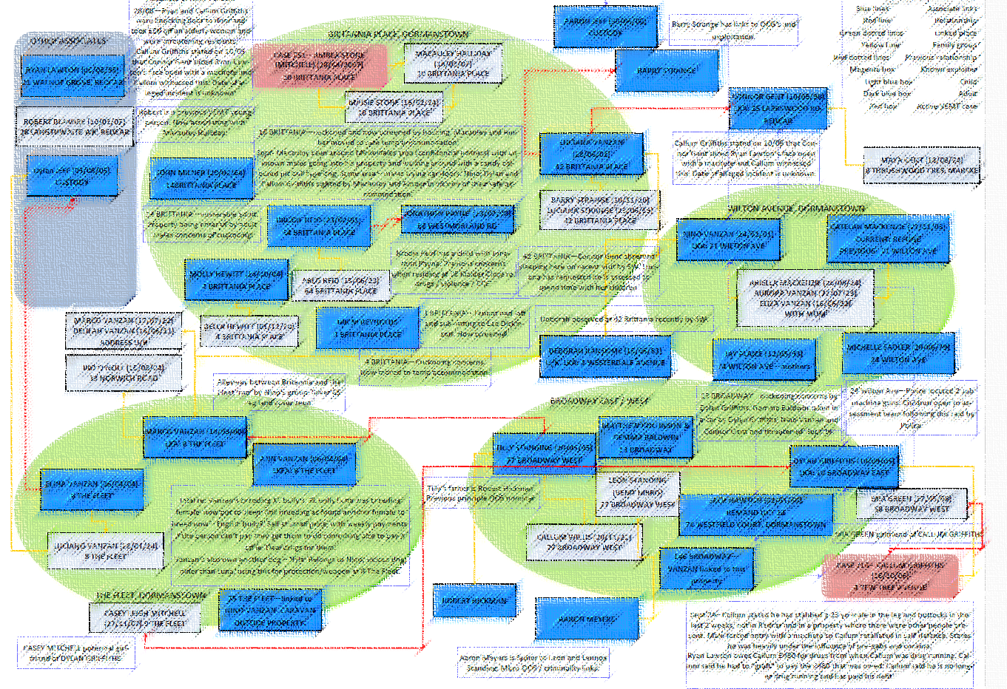
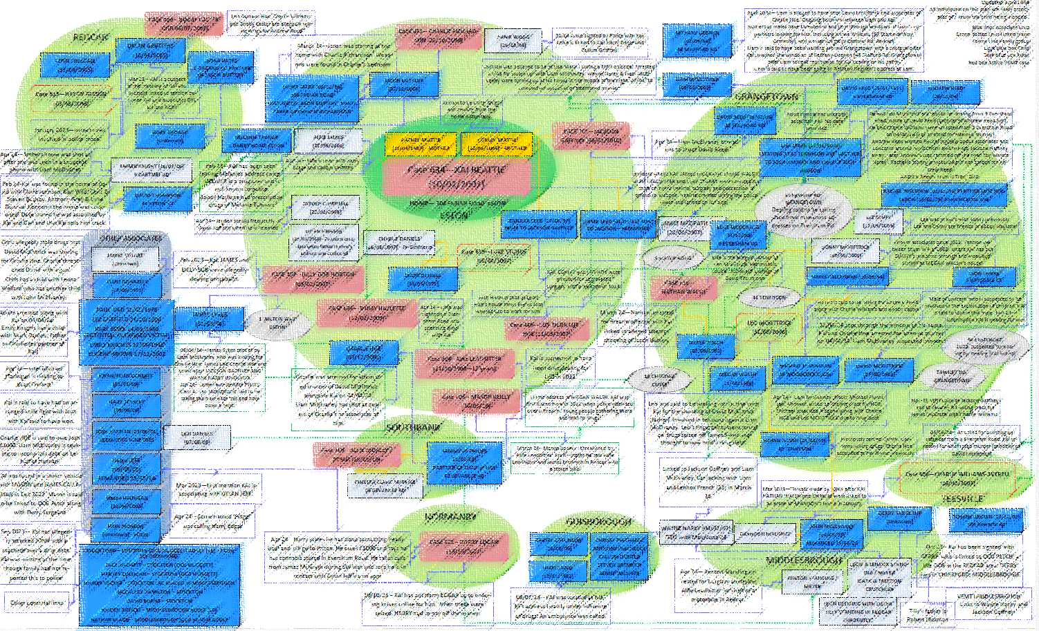

Mapping looks at the 3P model – Peers, Perpetrators, Places (and spaces). A “3P” mapping exercise is completed for any child or young person who we know or suspect to be being exploited.
Professionals hold and share information about multiple perpetrators and young people who are exploited in Redcar and Cleveland.
This is revisited regularly as an ongoing agenda item within core groups and ROTH reviews in respect of the individual child however ‘whole-cohort mapping exercises are also held regularly.
Notes:
Tool to understand peers, perpetrators, places
Triangulate the information from all agencies, to form a thorough understanding of risk and how we can work to reduce this.
The team led a case mapping session in April that saw 35 attendees from Education, Health, Youth Justice, Middlesbrough ASPIRE team, Early Help, Social Care, We are with you, Police, Neighbourhood Police and many more which led to a comprehensive case mapping following some recent incidents in the local area. This allowed for information sharing, safety planning and disruption activities across the Borough to safeguard young people at risk of exploitation.
The case mapping has been utilised in the intelligence gathering and OCG mapping by Cleveland Police.
This has also led to a number of disruption activities (next slide)

Slide 12
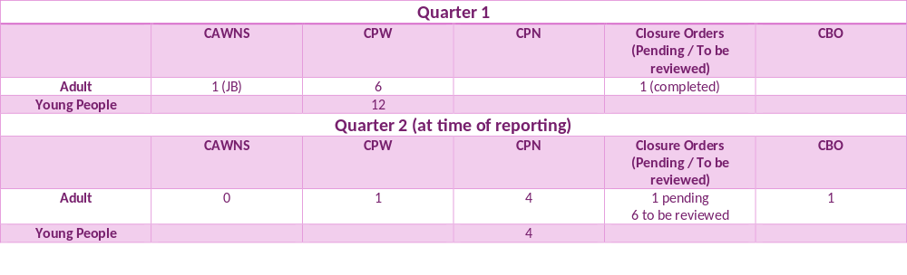
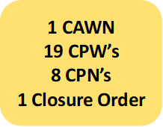
Disruption
Notes:
Quarter 1 and part of quarter 2 disruption activities.
Led to a number of young people and adults being deterred from associating with each other as said they ‘weren’t allowed’.
Also allowed parents and carers to feel empowered and not like all the decisions were on them, which can lead to a fear of reprisals and violence.
Prohibitions included within the CPW’s and CPN’s issued include:
ASB
Drugs
Threats of violence
Do not carry weapons
Do not conceal identity
Do not ride a motor bike or drive a vehicle without a licence of insurance
Exclusion zone; Eversham Road
A location risk assessment was also completed for a community hotspot in which there was increasing intelligence about drug dealing and child criminal exploitation in order to determine what safety measures and disruption activity could take place.
Threat to life/Osman Warnings
The threat to life notices were issued on the below:
Redcar family, 17 year old female. At risk due to being seen in a photo with an OCG member. Targeted by nominals and young people from the opposing OCG who were seeking out the adult male for retribution.
Grangetown family, 17 year old male. Young person at very high risk of CCE open to the SAFE team. Exploited for high level drug running for an OCG and intelligence around seeking retribution against an opposing OCG.
Grangetown family, female with young children who were all threatened at knife point due to females links/association with an OCG member. Targeted by nominals and young people from the opposing OCG who were seeking out the adult male for retribution.
Middlesbrough family, links to OCG. No children at this address but SAFE team added to mapping to understand the links to this family.
Grangetown family, links to young people open to the SAFE team, added to case mapping.
Grangetown family, 17 year old open to the SAFE team, relocated out of area and SAFE team identified place of safety for 17 year old to reside and contributed to risk assessments for Care Proceedings of younger sibling. Exploited for CCE and deemed significant member of an OCG.
Grangetown family, 17 year old exploited for CCE and deemed significant member of an OCG. Open to SAFE team.

Slide 13
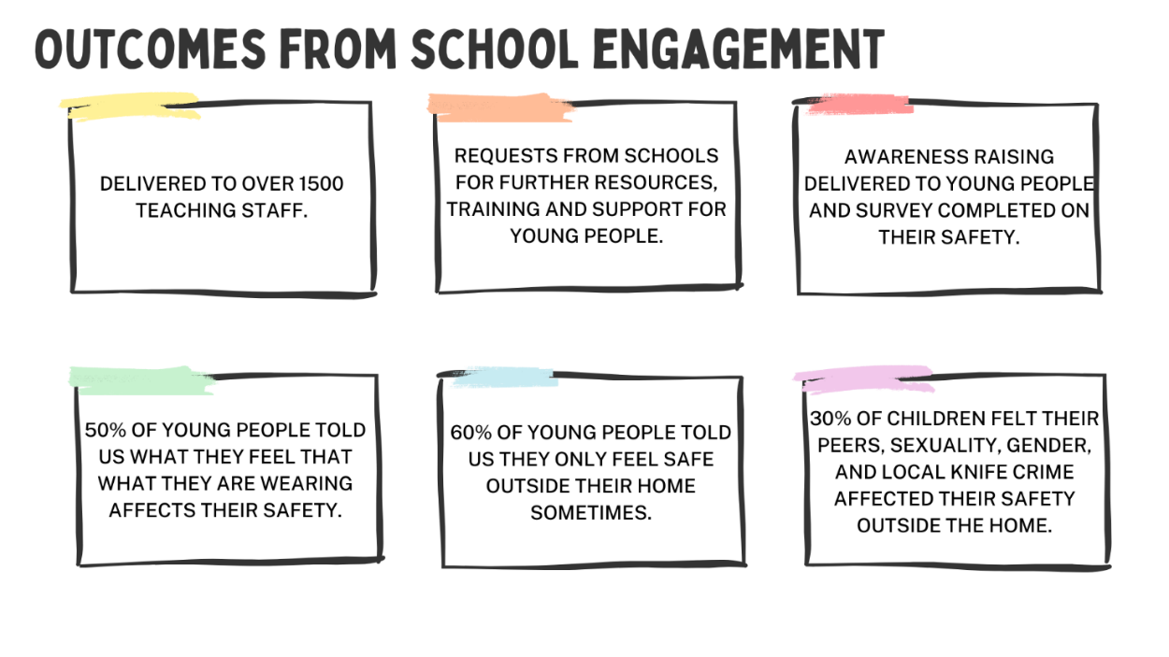

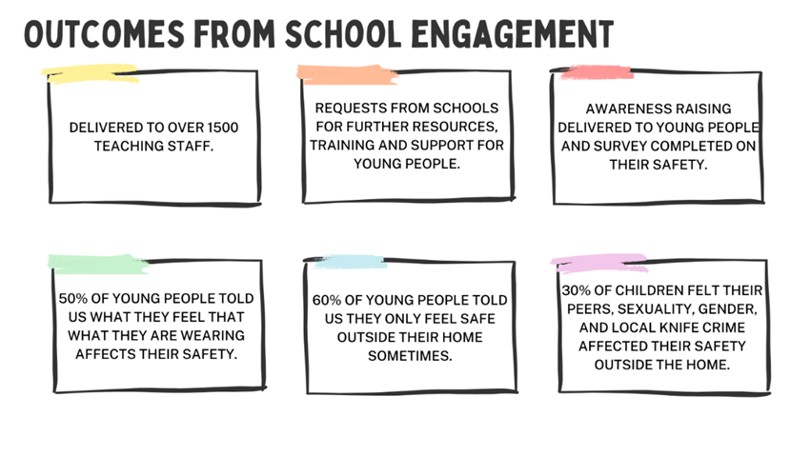
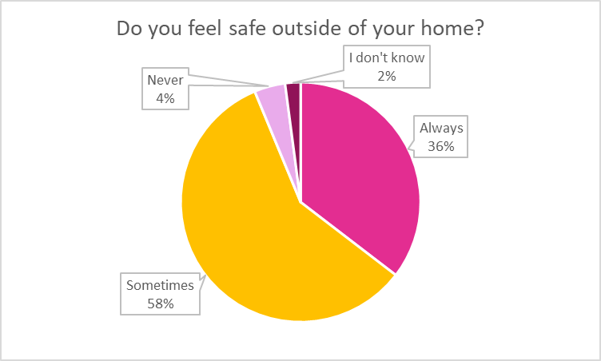
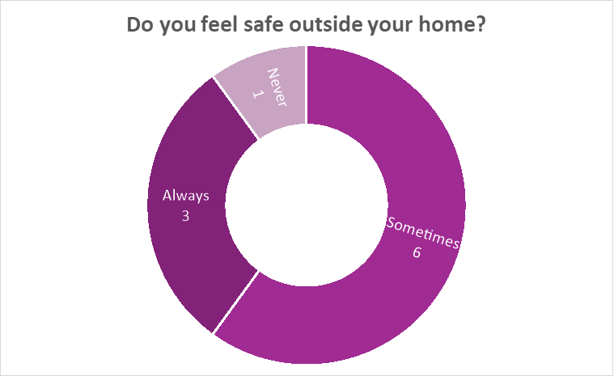
1529 TOTAL STAFF
913 SECONDARY & ALT PROVISION
616 PRIMARY
Notes:
The team have delivered training to teaching staff across Primary schools, Secondary schools and Alternative education provisions across the Borough, as well as holding a group discussion and survey with young people at Prior Pursglove College and delivery to year 10 pupils at Nunthorpe Academy. There is a plan to deliver within lesson time to all Yr 7 and 10 students within the Borough throughout the current school year.
Education specialist now in role – supporting with direct work with children and parents/carers (challenging school systems/processes with education colleagues to prevent exclusions), working with education colleagues and schools to provide training and raise awareness, and working in line with the educations strategy’s key priority around contextual safeguarding to address at a strategic level.

Slide 14
Next steps
School and Education work
Social Media
Community Engagement
Upskilling workforce
Work with external partners
Disruption activity
Prevention
Direct work
Raising awareness
Notes:
Clear hold build within Grangetown area in R&C to respond to and address serious violence and organised crime
Work with education and schools – education specialist
Work with communities and community groups – attendance and awareness raising at events, via QR codes, places and spaces
Social media awareness raising

Slide 15

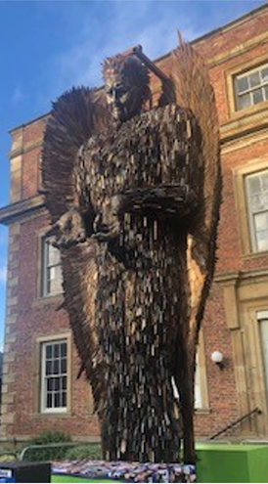
ROTH
Risk Outside the Home

Slide 16
Risk Outside the Home (ROTH)
ROTH takes a ‘Contextual Safeguarding Approach’ to understand and respond to children and young people who are exposed to or at risk of significant harm due to risk outside the home also referred to as extra-familial harm.
The ROTH pathway allows us to identify, assess and intervene with the contexts where this harm is happening. For example, this may be in a local park, on a high-street, in a school, an online platform, and in young person’s connections with similar-age peers as well as adults unconnected to their families.
Notes:
The ROTH pathway organises a professional response via protection planning, when a young person is at risk of significant harm outside the home. The ROTH pathway is similar to the traditional Child Protection framework however the aims to address the risks within their contexts.

Slide 17
Phase 1: Wiltshire
Phase 2:
Redcar Southampton
Leeds
Wiltshire
Phase 3:
Redcar Southampton Leeds
Wiltshire
Risk Outside of the Home Child Protection Pathways: Learning from Phase 2 Pilots (contextualsafeguarding.org.uk)
Notes:
Phase 1 the research team worked with Wiltshire to explore Contextual Safeguarding, what this means locally and nationally and begin to explore a Pathway
Phase 2 Following an ‘expression of interest’ we were one of 3 successful LA’s to secure a place within phase 2 of the pilot supported by Carlene Firmin, Durham University and the DfE.
In doing so we considered how we wanted to respond to contextual safeguarding within our demographic. We linked in with the other LA’s within the pilot, and also with our Regional counterparts in the NE 12 group who were not in the pilot however were exploring their own local responses to ROTH. We built upon the learning from other LA’s and the difficulties they had encountered. We decided that our ROTH pilot would run within the bounds of Child Protection. When threshold is met for significant harm, our statutory guidance leads us down a Section 47 route and into Child Protection conference. On this basis, we agreed our ROTH pathway would follow this course, however we adapted the timescales to respond to the more imminent need of CS; including holding more regular CP reviews, core groups and increasing professional visiting frequency.
The pathway, which we will go into in more detail as we go on, pushes us all to think differently about safeguarding. Increasing demand and time pressures are evident for all involved with the child / young person, however we are hopeful that our young people are reaping the benefit of this.
But its really important that we do so. There is clear guidance within WT 2023, (section 2) re supporting children at risk of, or experiencing, harm outside the home. We have a joint responsibility to safeguard and protect.
Phase 3 – we are invited to join phase 3 of the research study. This is a really exciting opportunity where we will seek to develop the ROTH pathway to support our care experienced children and young who are at risk of and experiencing harm outside of their placement setting.

Slide 18
Redcar Journey
Over the past 5 years, we have seen a significant increase in the number of children and young people who we recognise are at risk of, or who are being exploited with links to OCG’s.
We are excited to share that we have been invited to join Phase 3 of the ROTH Pilot which commenced in March 2024. This builds upon our work within Phase 2 of the pilot which many of you have been involved in.
Within Phase 3 we will continue to develop our knowledge and understanding of Contextual Safeguarding in the wider sense but more importantly within our local demographic. We will continue to hold ROTH CP conference and further develop this pathway. We will also look at how the pilot pathway can support other children and families including Children in Our Care.
Notes:
Within the ROTH Child Protection arena we have seen many successes for our children and young people. In particular we are seeing a theme that the duration of ROTH Child Protection Conferences is shorter than the standard Child Protection pathway; with risks reducing and protection planning ending positively. Professional intervention and support is intense within the ROTH pathway and this appears beneficial. We are really looking forward to working closely with the SAFE team as we continue to develop the ROTH pathway.

Slide 19
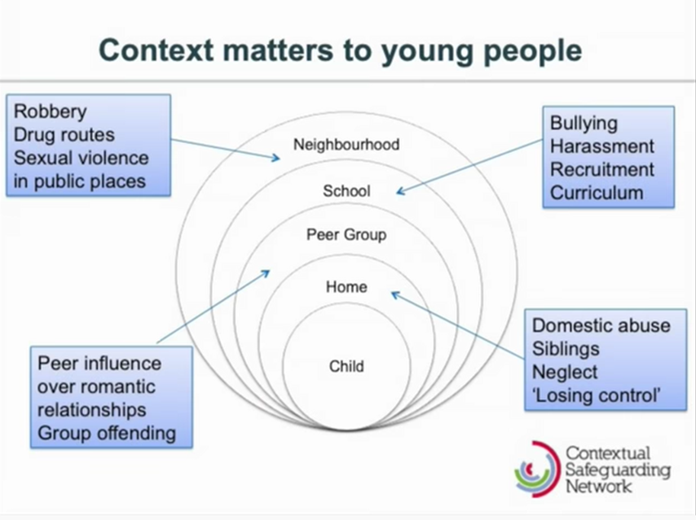
Context Weighting
Notes:
There are two main differences around how we understand the risks and mitigate against it – these are the context weighting discussions and the ROTH plan itself.
So what is different in the conference itself and what are we looking at differently?
Whilst we know school / health needs are important its about shifting our thinking.
What / Who / Where is the risk, What / Who reduces the risk and Where is safe, What do we need to know more about?

Slide 20

Places
TS6 area
North Yorkshire
Redcar/Dormanstown
Misadventure/ risk taking
behaviours
Friendship groups
Vulnerable to
exploitation/ exploiting
Substance misuse
Cannabis
Pre gab
Notes:
We then measure and evidence the risks. This is an example of context weighting.
Friendship group is the biggest context as this is pulling the young person into the other areas of concern
Places – what do we know about the specifics, postcode areas, outside of Redcar
This then links into being vulnerable to exploitation or even being the exploiter
Use of drugs – impacting upon risk taking behaviour, risk of misadventure

Slide 21
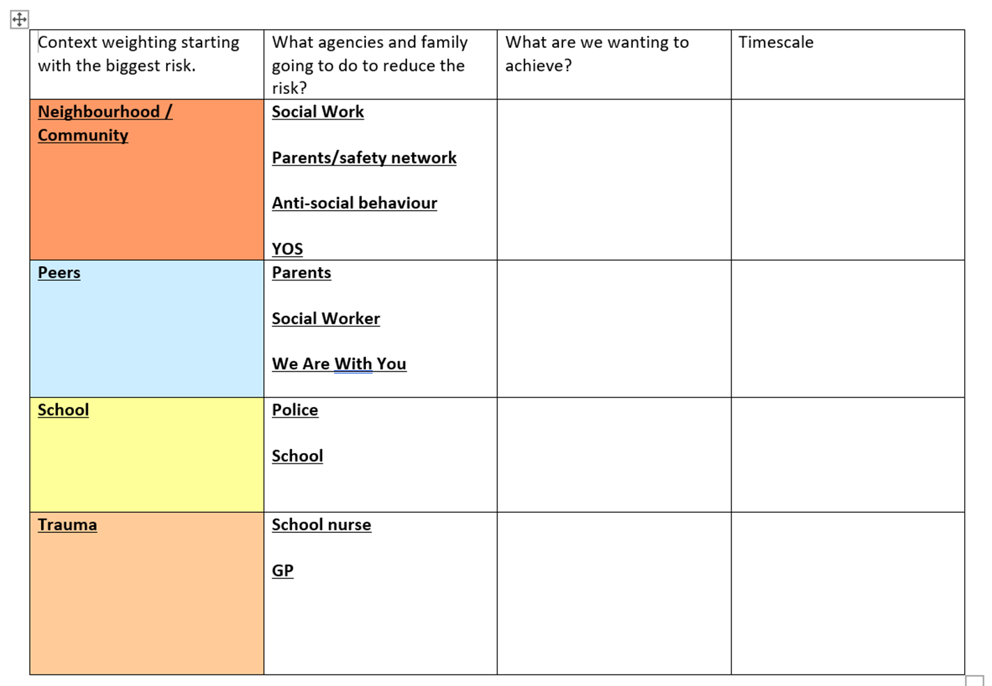
What does a ROTH plan look like?
Notes:
This is an example of a ROTH plan.

Slide 22
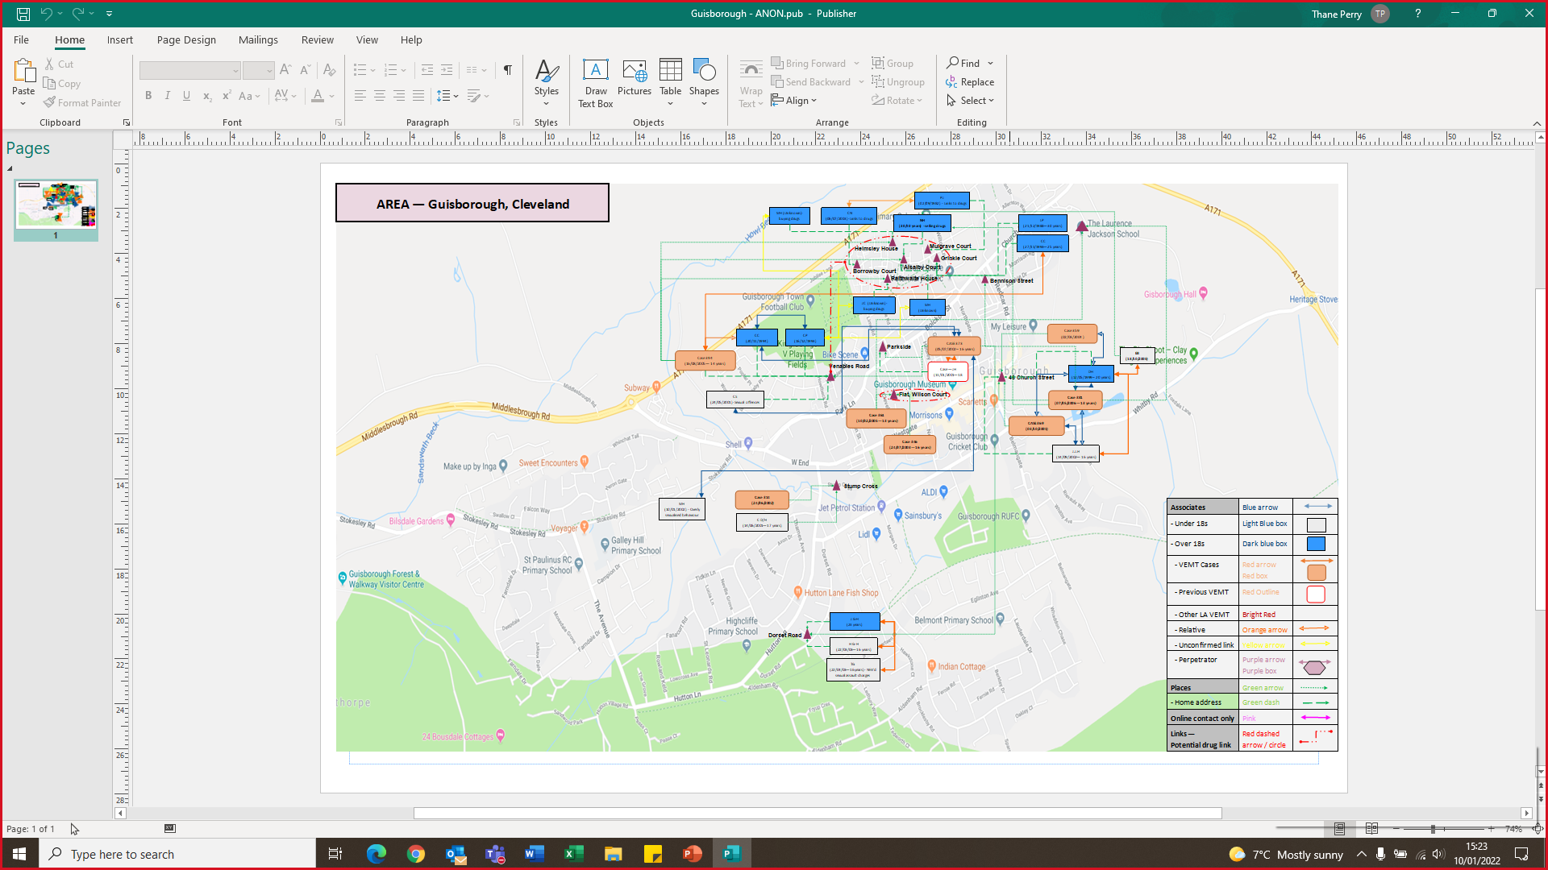
Mapping
Mapping is an integral part of the ROTH planning.
Mapping looks at the 3P model – Peers, Perpetrators, Places (and spaces)
This revisited regularly as an ongoing agenda item within core groups and ROTH reviews.
Notes:
We use mapping as a tool to understand perpetrators, people, places (and spaces)
We use mapping to triangulate the information from all agencies, to form a thorough understanding of risk and how we can work to reduce this.

Slide 23
Findings so far and Why..
15 children have been subject to ROTH plans in total.
14 ROTH plans have ended.
1 child’s ROTH plan was removed as she became a CIOC.
On average the ROTH plans ended within 6.5 months.
There is currently only 1 child subject to a ROTH plan.
Notes:
ROTH is solely extra familiar harm. It is rare in an Authority for risks to be solely outside the home.
14 plans in total since the pilot went live in December 2022.
Of the 7 ROTH plans that ended, 2 closed to Children’s Services, 4 families accepted support via the CIN framework and 1 young person came into the care of the LA. This was due to her family feeling unable to manage the risk outside and requesting accommodation rather than risk being identified within the home.
On a traditional CP pathway, statutory guidance advises us not to consider removing a CP plan until the second RCPC at 9 months. We know that CP plans can often run for longer than 9 months on the traditional pathway.
We feel that the more timely intervention, the more information that is being shared; thus allowing us to respond to the contexts at the current time and create safety.

Slide 24
Feedback from parents and professionals
“It was so good, and it allowed us to see where the risks really were” School Nurse
“We felt like things weren’t working well but it actually allowed us to see the progress” Parent and Aunt
“**** has a lot of respect for you. He’s felt supported by you, and I feel safe sharing delicate information” Parent
" I always feel included and involved, I am supported and questions about things I might not understand are always answered. I really worry about XXX but I know we are all doing everything we can" . Grandmother

Slide 25
Feedback from parents and professionals
" I always feel included and involved, I am supported and questions about things I might not understand are always answered. I really worry about XXX but I know we are all doing everything we can" . Grandmother
" I think people see XXX as vulnerable now rather than a trouble causer, the pressure we have lived with feels shared out. The ROTH plan has helped things get better quicker, he isn't missing as much, he comes home, and he has made relationships with professionals I didn't think he would Like Kirsty and Rita." Grandmother
"XXX is alright he says he is stressed, but he's done so well , all the trouble in Grange town he's not going out a lot, not involved. I believe it is beneficial, it all works. This has helped because its got everyone around the table and there is someone independent who can make sure we have the right conversations in the room. We feel we have a voice (family) at the meetings.“

Slide 26
Thank you
Any questions?
Please contact
ROTH -
Sarah Edwards- Sarah.Edwards@redcar-cleveland.gov.uk
Gemma Dixon – Gemma.Dixon@redcar-cleveland.gov.uk
Olivia Allen – Olivia.Allen@redcar-cleveland.gov.uk
SAFE -
Rebecca Cheesman – Rebecca.Cheesman@redcar-cleveland.gov.uk
Louise Stephens – Louise.Stephens@redcar-cleveland.gov.uk

